Slide 1
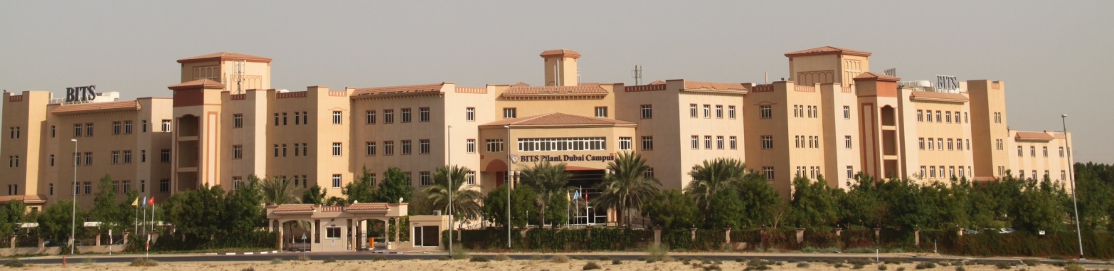
CS F301: Principles of Programing Languages

Slide 2
Contents
Language Evaluation Criteria
Features related to
Readability
Writability
Reliability
Cost

Slide 3
Language Evaluation Criteria
Readability: the ease with which programs can be read and understood
Writability: the ease with which a language can be used to create programs
Reliability: a program performs to its specifications under all conditions
Cost: Cost efficient

Slide 4
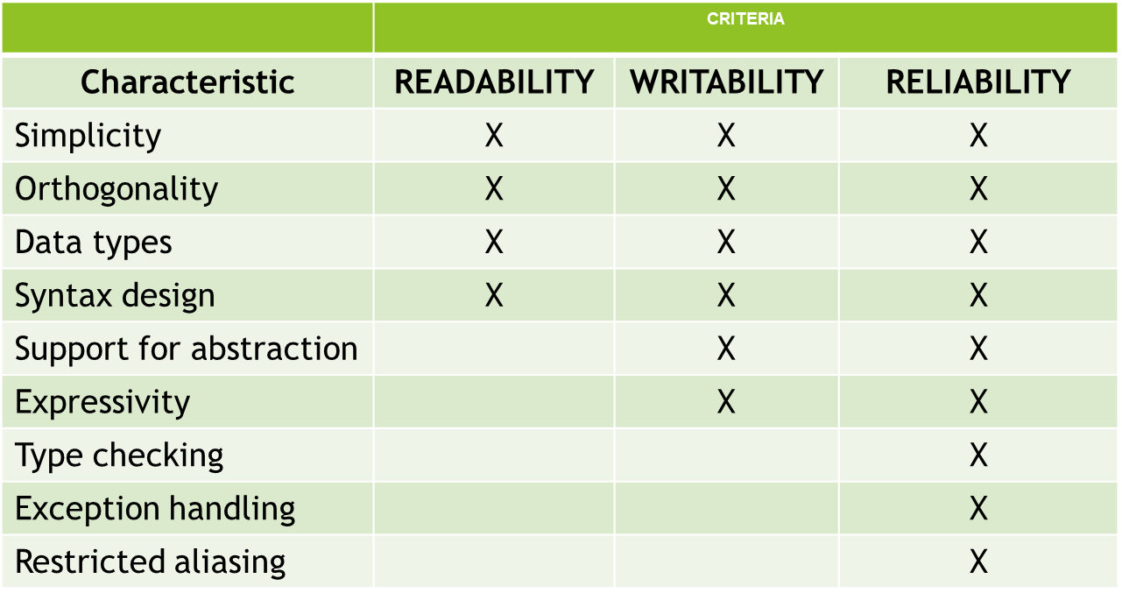
Language Evaluation Criteria

Slide 5
Features Related to Readability
1. Simplicity:
Fewer features and basic constructs
Readability problems occur whenever program’s author uses a subset different from that familiar to reader
Fewer feature multiplicity (i.e., doing the same operation with different ways) Eg. Incrementing a variable in Java
Count=count+1
Count+=1
Count++
++Count
Minimal operator overloading: Here a single operator symbol has more than one meaning.
Example: A Vector operand contains an ordered set of n elements, where n is called the length of the vector. All elements in a vector are same type scalar quantities, which may be a floating point number, an integer, a logical value, or a character.
Ambiguity: An user defining + between two vector operands. Actually the user, wanted to add only their respective first elements of the operands.

Slide 6
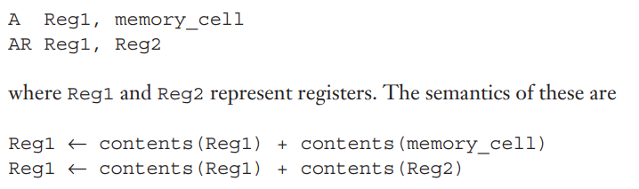
Features Related to Readability
2. Orthogonality:
Constructs in programming languages should be independent of each other. Should not be redundant.
every combination of features is meaningful
Example
The IBM mainframes have two instructions for adding two 32-bit integer values that reside in either memory or registers and replacing one of the two values with the sum.

Slide 7
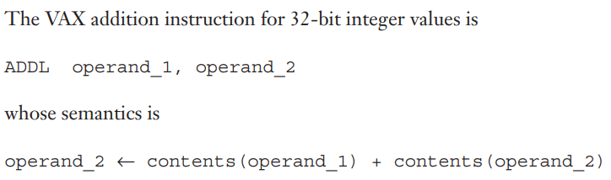
Features Related to Readability
Orthogonality:
The VAX instruction design is orthogonal in that a single
instruction can use either registers or memory cells as the
operands.

Slide 8
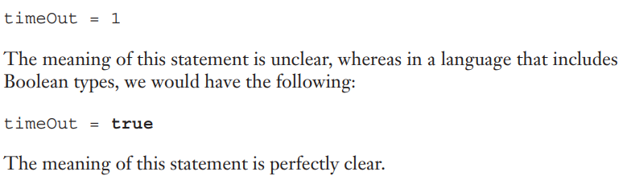
Features Related to Readability
3. Data types and structures:
Adequate facilities for defining data type & structure
For example, suppose a numeric type is used for an indicator flag because there is no Boolean type in the language.

Slide 9
Features Related to Readability
4. Syntax considerations:
a. Identifiers/Variables: Give meaningful names to your variables. C identifiers represent variables, functions, arrays, structures, unions, labels, etc. An identifier can be composed of letters such as uppercase, lowercase letters, underscore, digits, but the starting letter should be either an alphabet or an underscore. Max length of an identifier 31 characters.
b. Key Words: while, class, for - C uses braces for pairing control structures.

Slide 10
Features Related to Readability
4. Syntax considerations:
c. Semantic should follow directly from syntax:
Example: In C the use of static depends on the context of its appearance.
–If used as a variable inside a function, it means the variable is created at compile time.
If used on the definition of a variable that is outside all functions, it means the variable is visible only in the file in which its definition appears. It is not exported from that file.
If variable is not extern then it is not accessible from outside of the C file. (sometimes, we write multi file programs, if the code is too lengthy)

Slide 11
Features Related to Readability
4. Syntax considerations:
d. Form and meaning: self-descriptive constructs, meaningful keywords.
Semantics, or meaning, should follow directly from syntax, or form.
The appearance of the command grep indicates nothing to UNIX beginners.
g/regular_expression/p, which can obviously be abbreviated as grep, prints all lines in a file that contain substrings that match the regular expression.

Slide 12
Features Related to Writability
1. Support for abstraction:
Ability to define and use complex structures or operations in ways that allow details to be ignored
Abstraction in process (e.g. subprogram), data
A. Process Abstraction
Example is the use of a subprogram to implement a sort algorithm that is required several times in a program.
B. Data Abstraction
Consider a binary tree that stores integer data in its nodes. In C++ and Java, theses trees can be implemented by using an abstraction of a tree node in the form of a simple class with two pointers (or references) and an integer.
But languages such as Fortran 77 uses three parallel integer arrays, where two of the integers are used as subscripts to specify offspring nodes.

Slide 13
Features Related to Writability
2. Expressivity
A set of relatively convenient ways of specifying operations
Example 1: in C, the notation count++ is more convenient and shorter than count = count + 1.
Example 2: The inclusion of the for statement in Java makes writing counting loops easier than with the use of while

Slide 14
Features Related to Reliability
1. Type checking:
Testing for type errors,
Run-time type checking is expensive, compile-time type checking is more desirable.
It ensures that the operands of operator are of compatible type.
For example c=a+3*b
There b must be a type that permits multiplication by an integers.
Similarly operands for assignment can be evaluated.
Statically-typed languages: C, C++, C#, Java, Fortran etc.
Dynamically-typed languages: Groovy, JavaScript, Lisp, Lua, Objective-C, PHP, Prolog, Python, Ruby, Smalltalk and Tcl, etc.

Slide 15
Features Related to Reliability
2. Exception handling:
Intercept run-time errors & take corrective measures
Ada, C++, Java, and C# include extensive capabilities for exception handling.
3. Aliasing:
Presence of two or more distinct names for the same memory location.
Programmer must always remember that changing the value pointed to by one of the two, changes the value referenced by the other.
In C, union members and pointers set to point to the same variable.

Slide 16
Cost
Training programmers to use language
Writing programs (closeness to particular applications)
Compiling programs
Executing programs: run-time type checking
Language implementation system: availability of free compilers
Reliability: poor reliability leads to high costs
Maintaining programs.
Portability (“standardization of the language” )
Generality (the applicability to a wide range of applications)

Slide 17
References
Chapter 2, Ravi Sethi, "Programming Languages: Concepts and Constructs" 2nd Edition by Addison Wesley, 2006.
David A Watt, William Findlay, “Programming Language Design Concepts”, John Wiley & Sons, Ltd., 2004

Slide 18
Thank You!

